Slide 1
Word2vec
박준형
데이터인텔리전스 연구실
irish07@korea.ac.kr

Slide 2
Class Lab - Schedule & Assignment
Neural Network Introduction (~10/14)
2. Skip-gram / CBOW (~10/28)
(Basic) Softmax
3. Hierarchical Softmax / Negative sampling (~11/11)
Subsampling

Slide 3
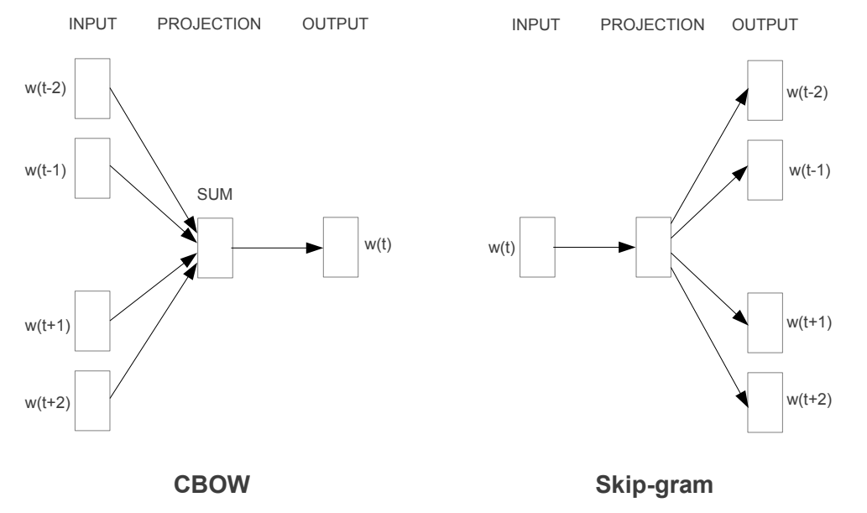
Class Lab - Schedule & Assignment
T. Mikolov, K. Chen, G. Corrado, J. Dean, “Efficient Estimation of Word Representations in Vector Space”

Slide 4
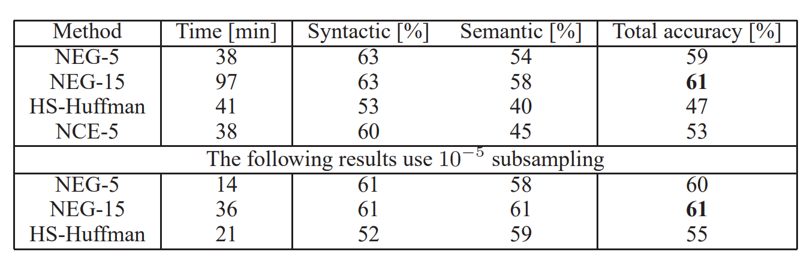
Class Lab - Schedule & Assignment
T. Mikolov, I. Sutskever, K. Chen, G. Corrado, J. Dean, “Distributed Representations of Words and Phrases and their Compositionality”

Slide 5
Class Lab - Schedule & Assignment
000000
100000
000100
apple
banana
One-hot encoding
grape
orange
strawberry
watermelon
vector
apple
orange

Slide 6
Class Lab - Schedule & Assignment
100000
Semantic Relation
000100
Syntactic Relation
apple
orange

Slide 7
Class Lab - Schedule & Assignment
Word
Continuous Feature Space

Slide 8
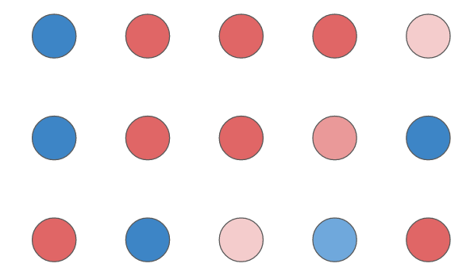

Class Lab - Schedule & Assignment
Word A
Word B
Word C

Slide 9
Class Lab - Schedule & Assignment
???
?
?
?
?
?
?
???
How to set features and values of them
???
???
???
With Neural Networks
???
Word

Slide 10
Word2vec
1 - Neural Network

Slide 11
How to Learn
Draw a line between circles and triangles!

Slide 12
How to Learn
Draw a line between circles and triangles!
Correct!

Slide 13
How to Learn
Draw a line between circles and triangles!
Wrong!

Slide 14
How to Learn
Draw a line between circles and triangles!
Wrong but better than the previous one

Slide 15
How to Learn
Draw a line between circles and triangles!
Correct!

Slide 16
How to Learn
Make a line
Find what is wrong
Modify it

Slide 17
Neural Network
Evaluation (Multi-Layer Perceptron)
Loss and Gradient (Backpropagation)
Update (SGD)

Slide 18
Neural Network
Evaluation (Multi-Layer Perceptron)
Loss and Gradient (Backpropagation)
Update (SGD)

Slide 19
Perceptron
Transform
Input
Output

Slide 20
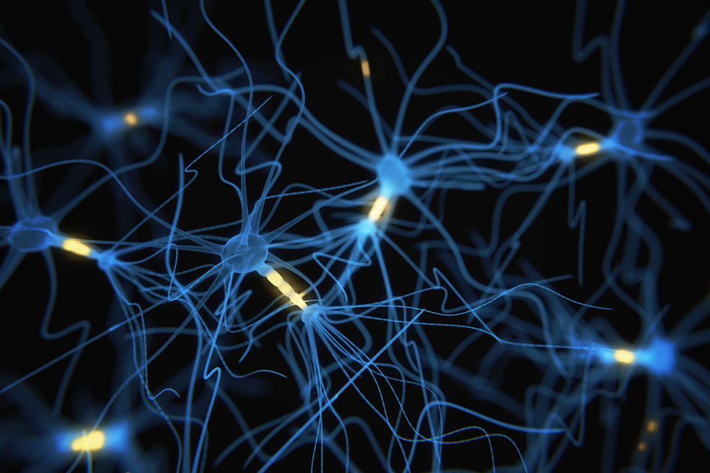
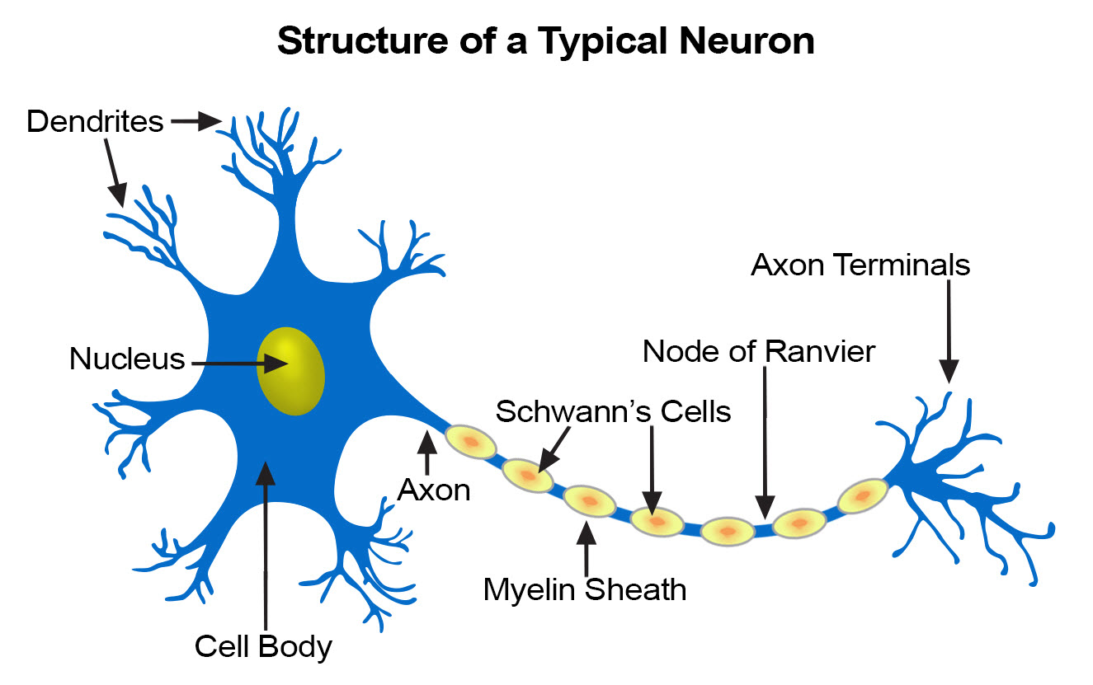
Perceptron

Slide 21
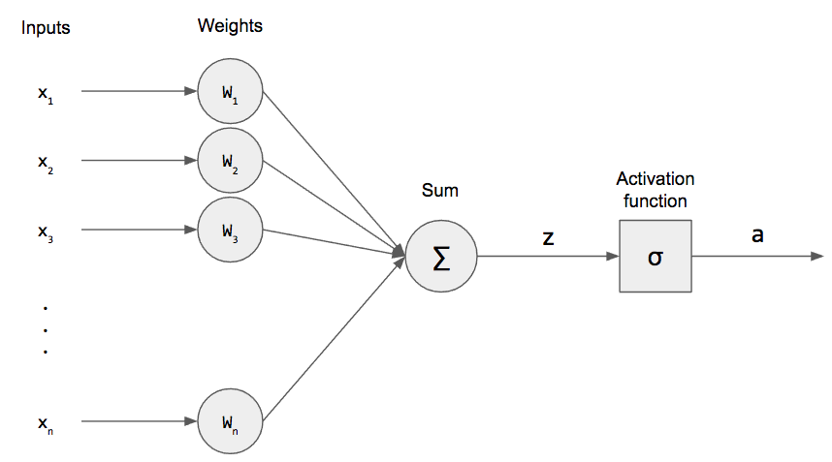
Perceptron
Weighted Sum + Nonlinear Function

Slide 22
Perceptron
$$z=w_{1}x_{1}+w_{2}x_{2}+…+w_{n}x_{n}+b$$

Slide 23
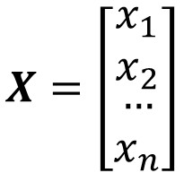
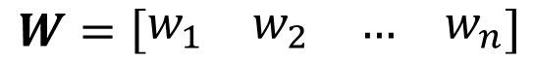
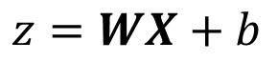
Perceptron
$$z=w_{1}x_{1}+w_{2}x_{2}+…+w_{n}x_{n}+b$$
$$z=WX+b$$
$$X=\left[\begin{matrix}\begin{matrix}x_{1} \\ x_{2}\end{matrix} \\ \begin{matrix}… \\ x_{n}\end{matrix}\end{matrix}\right]$$
$$W=\left[\begin{matrix}\begin{matrix}w_{1} & w_{2}\end{matrix} & \begin{matrix}… & w_{n}\end{matrix}\end{matrix}\right]$$
Matrix Multiplication

Slide 24
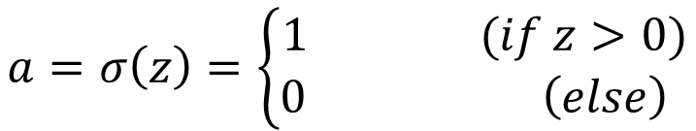
Perceptron
$$z=w_{1}x_{1}+w_{2}x_{2}+…+w_{n}x_{n}+b$$
$$z=WX+b$$
$$a=σ\left(z\right)=\left\{\begin{aligned}1 (if z>0) \\ 0 \left(else\right) \end{aligned}\right.$$

Slide 25
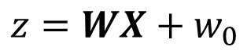
Perceptron
Perceptron can deal with linearly separable problems
$$z=WX+w_{0}$$

Slide 26
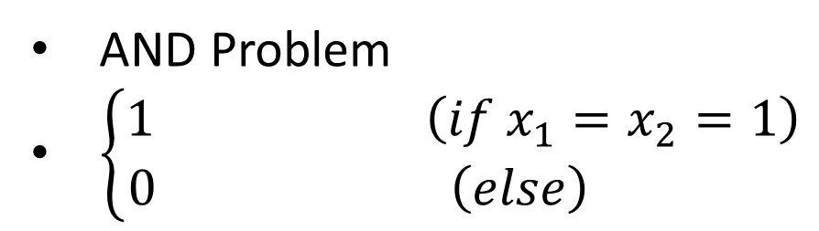
Perceptron
Perceptron can deal with linearly separable problems
AND Problem
$\left\{\begin{aligned}1 \left(if x_{1}=x_{2}=1\right) \\ 0 \left(else\right) \end{aligned}\right.$

Slide 27
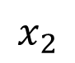

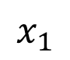
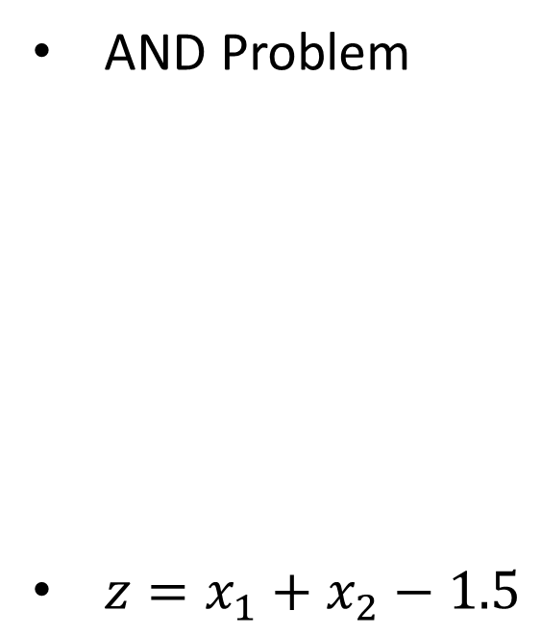

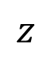
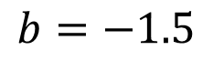

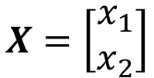

Perceptron
Perceptron can deal with linearly separable problems
AND Problem
$z=x_{1}+x_{2}−1.5$
$$W=\left[\begin{matrix}1 & 1\end{matrix}\right]$$
$$X=\left[\begin{aligned}x_{1} \\ x_{2}\end{aligned}\right]$$
$$b=−1.5$$
$$x_{1}$$
$$1$$
$Σ$
$$z$$
$$x_{2}$$
$$1$$

Slide 28
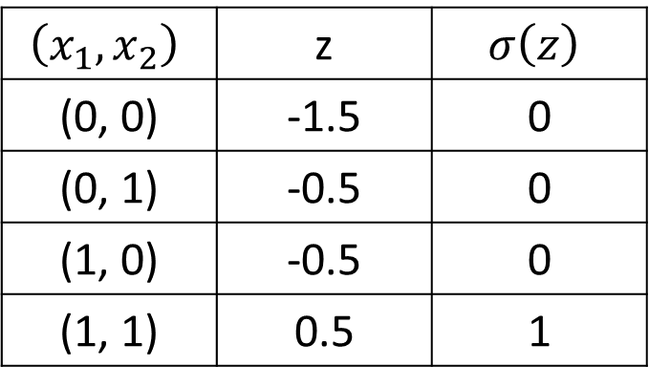
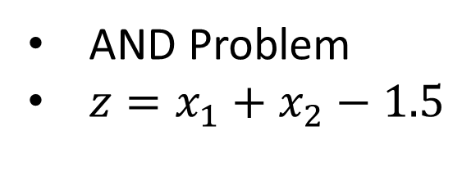
Perceptron
Perceptron can deal with linearly separable problems
AND Problem
$z=x_{1}+x_{2}−1.5$
$$\left(x_{1},x_{2}\right)$$ | z | $$σ\left(z\right)$$
(0, 0) | -1.5 | 0
(0, 1) | -0.5 | 0
(1, 0) | -0.5 | 0
(1, 1) | 0.5 | 1

Slide 29
Multi-layer Perceptron
XOR Problem
Draw a line between circles and triangles!

Slide 30
Multi-layer Perceptron
XOR Problem
Draw two lines between circles and triangles!

Slide 31
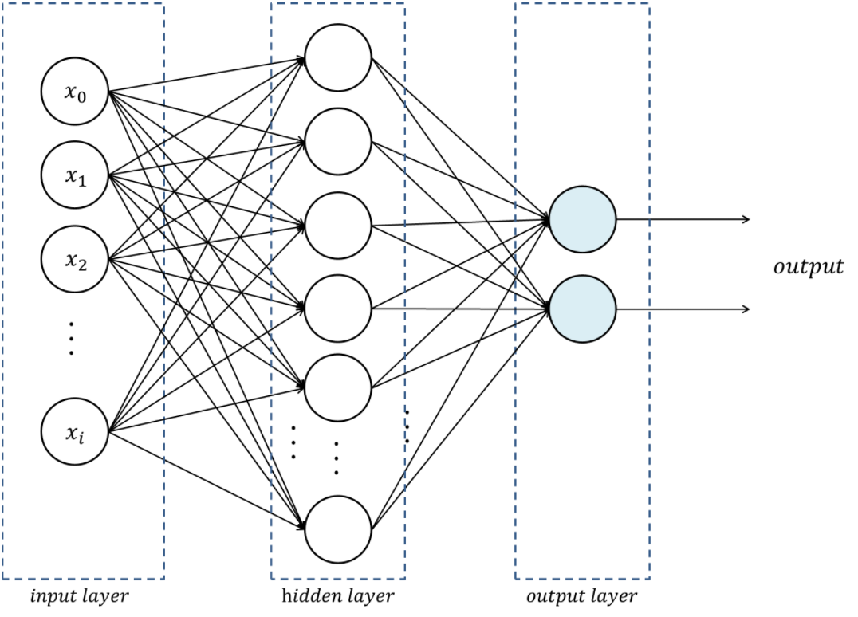
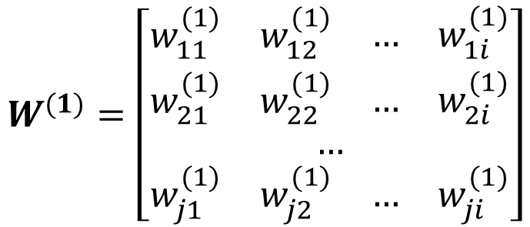
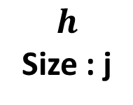
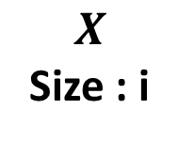
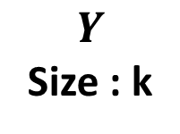
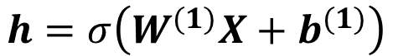
Multi-layer Perceptron
Stack of perceptron
$$h=σ\left(W^{(1)}X+b^{(1)}\right)$$
$$W^{(1)}=\left[\begin{aligned}\begin{matrix}\begin{matrix}w_{11}^{(1)} & w_{12}^{(1)}\end{matrix} & \begin{matrix}… & w_{1i}^{(1)}\end{matrix}\end{matrix} \\ \begin{matrix}\begin{matrix}w_{21}^{(1)} & w_{22}^{(1)}\end{matrix} & \begin{matrix}… & w_{2i}^{(1)}\end{matrix}\end{matrix} \\ … \\ \begin{matrix}\begin{matrix}w_{j1}^{(1)} & w_{j2}^{(1)}\end{matrix} & \begin{matrix}… & w_{ji}^{(1)}\end{matrix}\end{matrix}\end{aligned}\right]$$
$$X$$
Size : i
$$h$$
Size : j
$$Y$$
Size : k
( j x i ) matrix

Slide 32
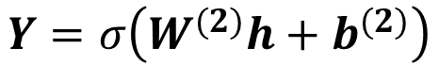
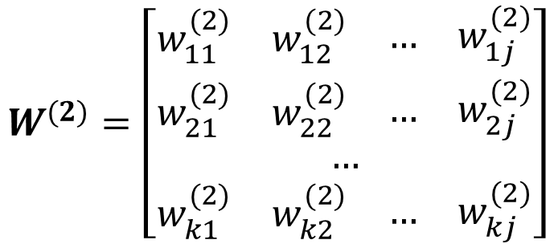
Multi-layer Perceptron
Stack of perceptron
$$h=σ\left(W^{(1)}X+b^{(1)}\right)$$
$$Y=σ\left(W^{(2)}h+b^{(2)}\right)$$
$$W^{(2)}=\left[\begin{aligned}\begin{matrix}\begin{matrix}w_{11}^{(2)} & w_{12}^{(2)}\end{matrix} & \begin{matrix}… & w_{1j}^{(2)}\end{matrix}\end{matrix} \\ \begin{matrix}\begin{matrix}w_{21}^{(2)} & w_{22}^{(2)}\end{matrix} & \begin{matrix}… & w_{2j}^{(2)}\end{matrix}\end{matrix} \\ … \\ \begin{matrix}\begin{matrix}w_{k1}^{(2)} & w_{k2}^{(2)}\end{matrix} & \begin{matrix}… & w_{kj}^{(2)}\end{matrix}\end{matrix}\end{aligned}\right]$$
$$X$$
Size : i
$$h$$
Size : j
$$Y$$
Size : k
( k x j ) matrix

Slide 33
Multi-layer Perceptron
XOR Problem

Slide 34
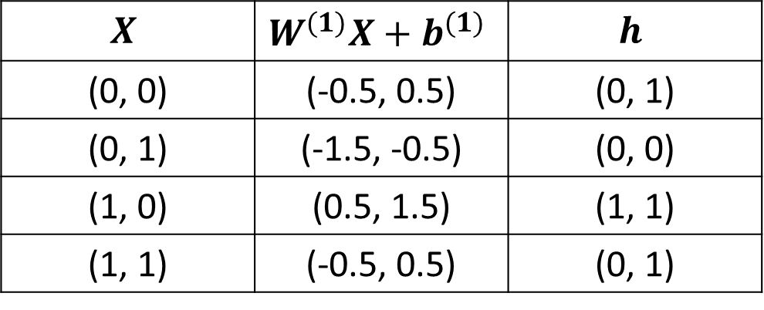
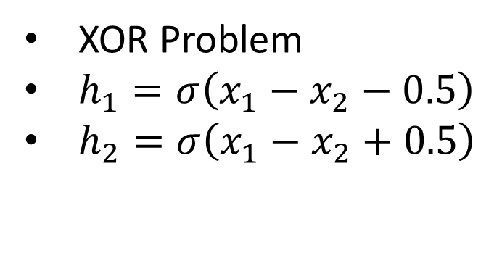
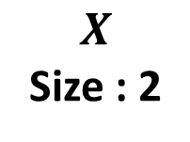
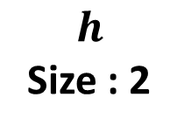
Multi-layer Perceptron
XOR Problem
$h_{1}=σ\left(x_{1}−x_{2}−0.5\right)$
$h_{2}=σ\left(x_{1}−x_{2}+0.5\right)$
$$X$$ | $$W^{(1)}X+b^{(1)}$$ | $$h$$
(0, 0) | (-0.5, 0.5) | (0, 1)
(0, 1) | (-1.5, -0.5) | (0, 0)
(1, 0) | (0.5, 1.5) | (1, 1)
(1, 1) | (-0.5, 0.5) | (0, 1)
$$X$$
Size : 2
$$h$$
Size : 2

Slide 35
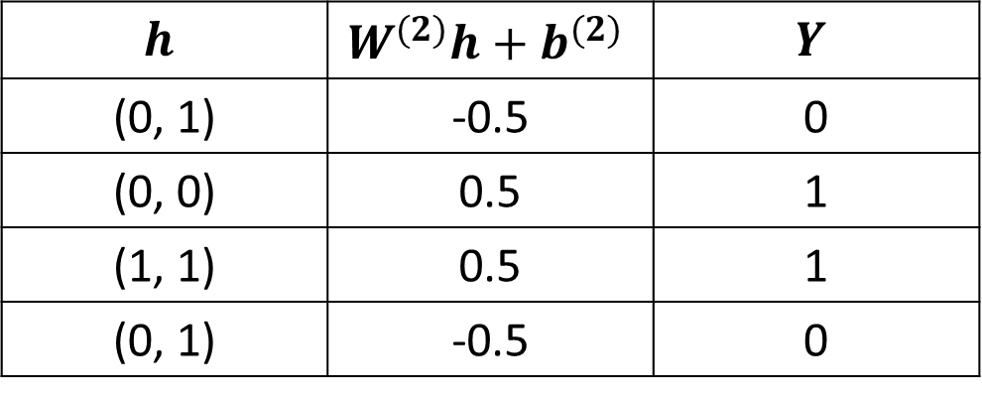
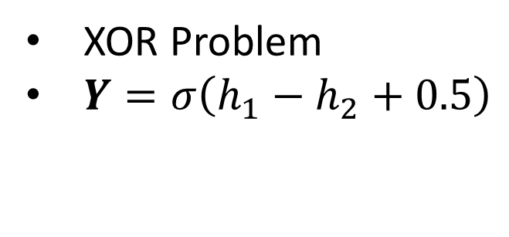
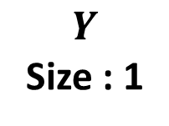
Multi-layer Perceptron
XOR Problem
$Y=σ\left(h_{1}−h_{2}+0.5\right)$
$$h$$ | $$W^{(2)}h+b^{(2)}$$ | $$Y$$
(0, 1) | -0.5 | 0
(0, 0) | 0.5 | 1
(1, 1) | 0.5 | 1
(0, 1) | -0.5 | 0
$$X$$
Size : 2
$$h$$
Size : 2
$$Y$$
Size : 1

Slide 36
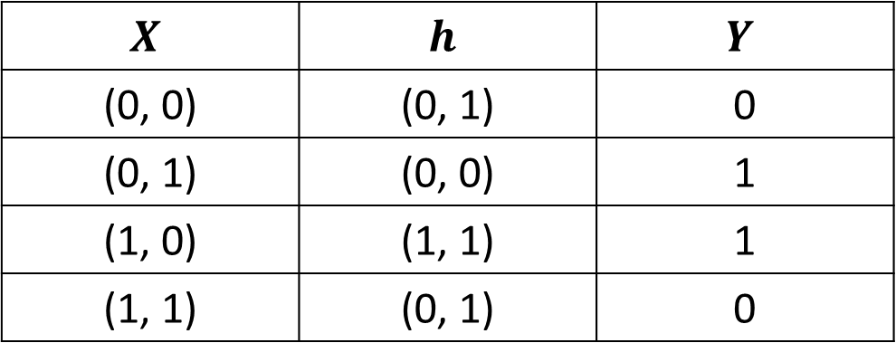
Multi-layer Perceptron
XOR Problem
$$X$$ | $$h$$ | $$Y$$
(0, 0) | (0, 1) | 0
(0, 1) | (0, 0) | 1
(1, 0) | (1, 1) | 1
(1, 1) | (0, 1) | 0
$$X$$
Size : 2
$$h$$
Size : 2
$$Y$$
Size : 1

Slide 37
Multi-layer Perceptron
2-layer Perceptron can deal with some nonlinear problems

Slide 38
Multi-layer Perceptron
3-layer Perceptron can deal with more complex problems

Slide 39

Multi-layer Perceptron
Activation function is needed for nonlinearity

Slide 40
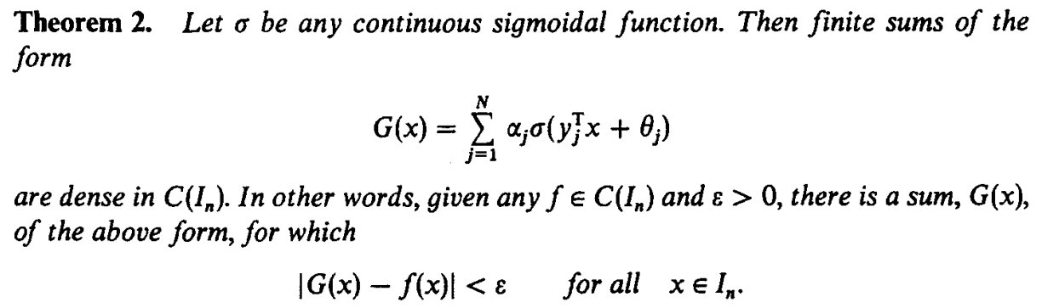
Multi-layer Perceptron
Activation function is needed for nonlinearity

Slide 41
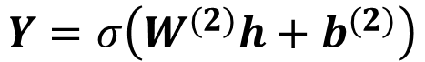
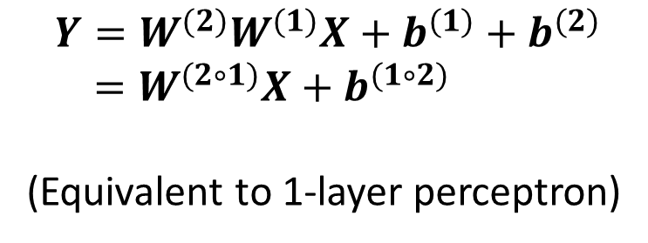
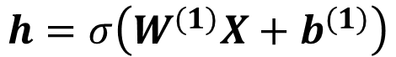
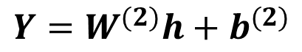
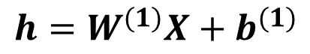
Multi-layer Perceptron
Activation function is needed for nonlinearity
With activation
Without activation
$$h=σ\left(W^{(1)}X+b^{(1)}\right)$$
$$h=W^{(1)}X+b^{(1)}$$
$$Y=σ\left(W^{(2)}h+b^{(2)}\right)$$
$$Y=W^{(2)}h+b^{(2)}$$
$$Y=σ\left(W^{(2)}σ\left(W^{(1)}X+b^{(1)}\right)+b^{(2)}\right)$$
$$Y=W^{(2)}W^{(1)}X+b^{(1)}+b^{(2)}$$
$=W^{(2∘1)}X+b^{(1∘2)}$
(Equivalent to 1-layer perceptron)

Slide 42
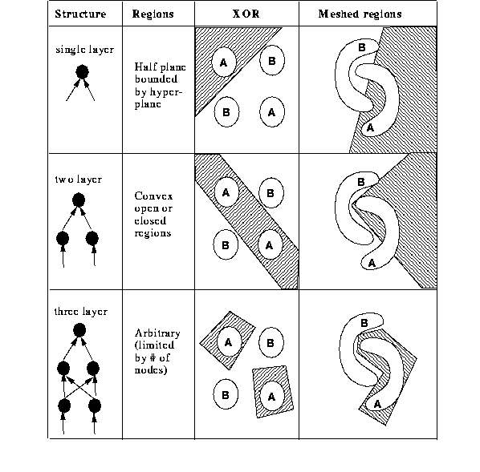
Multi-layer Perceptron
Deeper networks can represent more complex topology
Deeper = Better ?

Slide 43
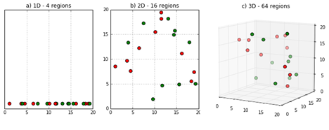
Multi-layer Perceptron
Curse of Dimensionality
Hard to optimize
Prone to overfit

Slide 44
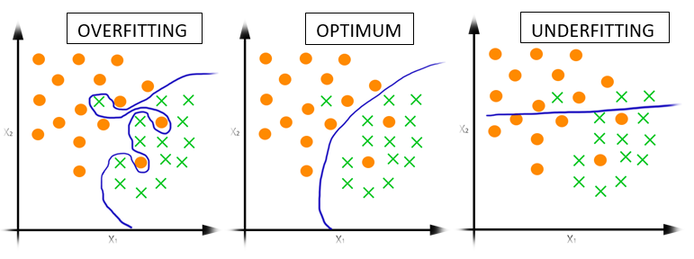
Multi-layer Perceptron
Overfitting

Slide 45
Neural Network
Evaluation (Multi-Layer Perceptron)
Loss and Gradient (Backpropagation)
Update (SGD)

Slide 46
Backpropagation

Slide 47
Backpropagation
4 incorrect examples
2 incorrect examples

Slide 48
Backpropagation
Cosine similarity : 0.5
Cosine similarity : 0.7

Slide 49
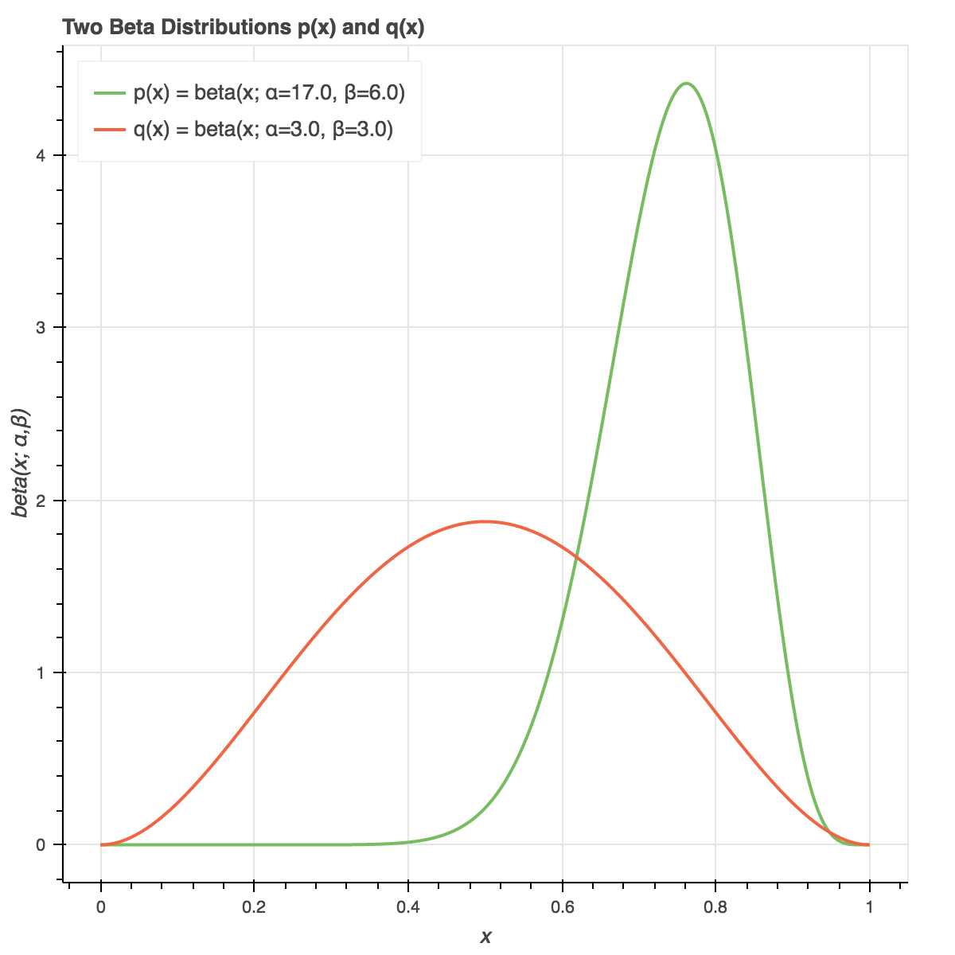
Backpropagation
Loss(=cost) : A real number that represents how much wrong it is
Prediction: 3.4
Answer: 3.7
Loss : 4
Loss : 0.09
Loss : 1.7

Slide 50
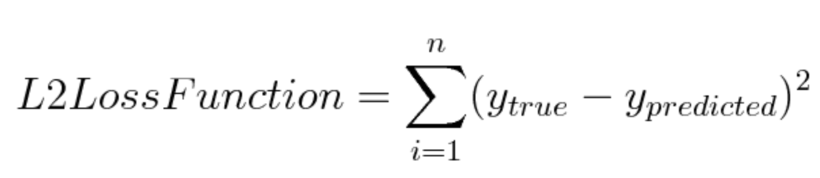
Backpropagation
L2-loss
Prediction: 3.4
Answer: 3.7
Measure distance between real values
Loss : 0.09

Slide 51
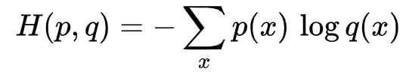
Backpropagation
Cross Entropy
Measure distance between two probability distribution
Mostly used in classification problems
Loss : 1.7

Slide 52

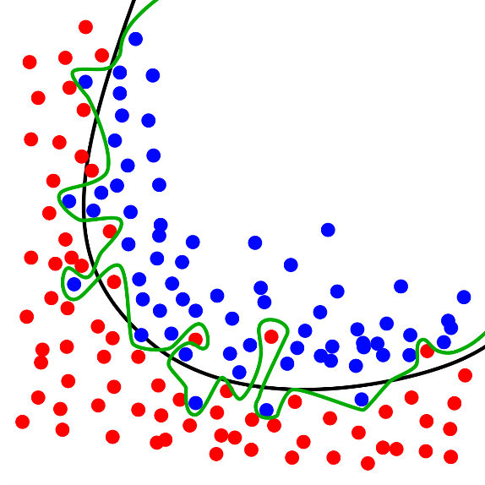
Regularization
Neural network overfitting problem
Neural network models can memorize the training data
-> when they meet unseen data (test data)

Slide 53
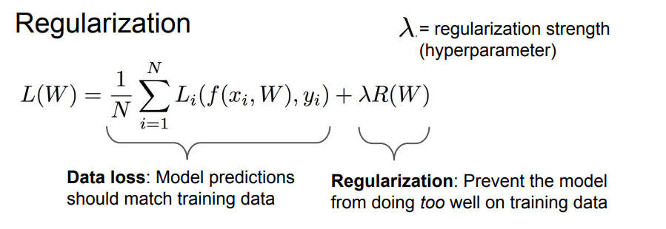
Regularization
Regularization and loss function

Slide 54

Regularization
Regularization and loss function
How sensitive to the input?
Near zero weights vs Large weights

Slide 55

Regularization
Regularization and loss function

Slide 56
Backpropagation
We should minimize the loss
How?

Slide 57

Backpropagation
We should minimize the loss using differentiation
Parameter : W
Loss function : J(W)

Slide 58

Backpropagation
We should minimize the loss using differentiation
Gradient : $\frac{∂J(w)}{∂w}$

Slide 59










Backpropagation
Backpropagation: Using chain rule, calculate gradient step- by-step
$x$
$×$
$$y$$
$$w$$
$+$
$$z$$
$σ$
$a$
$$b$$
Computational graph of $a=σ(wx+b)$

Slide 60






Backpropagation
Backpropagation: Using chain rule, calculate gradient step- by-step
$0.9$
$×$
$0.63$
$0.7$
$+$
$0.83$
$σ$
$0.70$
$0.2$

Slide 61










Backpropagation
Backpropagation: Using chain rule, calculate gradient step- by-step
$$x$$
$0.9$
$$y$$
$$a=\frac{1}{1+e^{−z}}$$
$×$
$0.63$
$$w$$
$$z$$
$$a$$
$0.7$
$+$
$0.83$
$σ$
$0.70$
$$b$$
$0.2$
$$\frac{∂J}{∂z}=\frac{∂J}{∂a}\frac{∂a}{∂z}$$
$$\frac{∂a}{∂z}=a×(1−a)$$
$$\frac{∂J}{∂a}=1$$

Slide 62






Backpropagation
Backpropagation: Using chain rule, calculate gradient step- by-step
$$x$$
$$\frac{∂J}{∂y}=\frac{∂J}{∂z}\frac{∂z}{∂y}$$
$0.9$
$$y$$
$×$
$0.63$
$$z=y+b^{(1)}$$
$$w$$
$$z$$
$$a$$
$0.7$
$+$
$0.83$
$σ$
$0.70$
$$b$$
$0.2$
$$\frac{∂J}{∂a}=1$$
$$\frac{∂z}{∂y}=1$$
$$\frac{∂z}{∂b}=1$$
$$\frac{∂J}{∂z}=0.21$$
$$\frac{∂J}{∂b}=\frac{∂J}{∂z}\frac{∂z}{∂b}$$

Slide 63







Backpropagation
Backpropagation: Using chain rule, calculate gradient step- by-step
$$\frac{∂J}{∂x}=\frac{∂J}{∂y}\frac{∂y}{∂x}$$
$$x$$
$$\frac{∂J}{∂y}=0.21$$
$0.9$
$$y=wx$$
$$y$$
$×$
$0.63$
$$w$$
$$z$$
$$a$$
$0.7$
$$\frac{∂y}{∂x}=w$$
$$\frac{∂y}{∂w}=x$$
$+$
$0.83$
$σ$
$0.70$
$$b$$
$0.2$
$$\frac{∂J}{∂a}=1$$
$$\frac{∂J}{∂w}=\frac{∂J}{∂y}\frac{∂y}{∂w}$$
$$\frac{∂J}{∂Z}=0.21$$
$$\frac{∂J}{∂b}=0.21$$

Slide 64


Backpropagation
Backpropagation: Using chain rule, calculate gradient step- by-step
$$\frac{∂J}{∂x}=0.147$$
$$\frac{∂J}{∂y}=0.21$$
$0.9$
$×$
$0.63$
$0.7$
$+$
$0.83$
$σ$
$0.70$
$$\frac{∂J}{∂w}=0.189$$
$0.2$
$$\frac{∂J}{∂a}=1$$
$$\frac{∂J}{∂Z}=0.21$$
$$\frac{∂J}{∂b}=0.21$$

Slide 65


Backpropagation
Backpropagation: Using chain rule, calculate gradient step- by-step
$$J=−log⁡(σ\left(w_{1}x_{1}+w_{2}x_{2}+w_{3}x_{3}+b\right))$$
Parameters : $w_{1},w_{2},w_{3}, b$

Slide 66


Backpropagation
Backpropagation: Using chain rule, calculate gradient step- by-step
$$J=−log⁡(σ\left(w_{1}x_{1}+w_{2}x_{2}+w_{3}x_{3}+b\right))$$
Parameters : $w_{1},w_{2},w_{3}, b$
Gradients : $\frac{∂J}{∂w_{1}},\frac{∂J}{∂w_{2}},\frac{∂J}{∂w_{3}},\frac{∂J}{∂b}$

Slide 67



Backpropagation
Backpropagation: Using chain rule, calculate gradient step- by-step
$$a=σ(w_{1}x_{1}+w_{2}x_{2}+w_{3}x_{3}+b)$$
$$J=−\log\left(a\right)$$
$\frac{∂J}{∂a}=−\frac{1}{a}$
$$\frac{∂J}{∂w_{1}}=\frac{∂J}{∂a}\frac{∂a}{∂w_{1}}$$
$$\frac{∂J}{∂w_{2}}=\frac{∂J}{∂a}\frac{∂a}{∂w_{2}}$$
$$\frac{∂J}{∂w_{3}}=\frac{∂J}{∂a}\frac{∂a}{∂w_{3}}$$
$$\frac{∂J}{∂b}=\frac{∂J}{∂a}\frac{∂a}{∂b}$$

Slide 68




Backpropagation
Backpropagation: Using chain rule, calculate gradient step- by-step
$$y=w_{1}x_{1}+w_{2}x_{2}+w_{3}x_{3}+b$$
$a=σ(y)$
$\frac{∂a}{∂y}=y(1−y)$
$J=−log⁡(a)$
$\frac{∂J}{∂a}=−\frac{1}{a}$
$$\frac{∂J}{∂w_{1}}=\frac{∂J}{∂a}\frac{∂a}{∂y}\frac{∂y}{∂w_{1}}$$
$$\frac{∂J}{∂w_{2}}=\frac{∂J}{∂a}\frac{∂a}{∂y}\frac{∂y}{∂w_{2}}$$
$$\frac{∂J}{∂w_{3}}=\frac{∂J}{∂a}\frac{∂a}{∂y}\frac{∂y}{∂w_{3}}$$
$$\frac{∂J}{∂b}=\frac{∂J}{∂a}\frac{∂a}{∂y}\frac{∂y}{∂b}$$

Slide 69


Backpropagation
Backpropagation: Using chain rule, calculate gradient step- by-step
$$y=w_{1}x_{1}+w_{2}x_{2}+w_{3}x_{3}+b$$
$a=σ(y)$
$\frac{∂a}{∂y}=y(1−y)$
$J=−log⁡(a)$
$\frac{∂J}{∂a}=−\frac{1}{a}$
$$\frac{∂J}{∂w_{1}}=\frac{∂J}{∂a}\frac{∂a}{∂y}\frac{∂y}{∂w_{1}}$$
$$\frac{∂J}{∂w_{2}}=\frac{∂J}{∂a}\frac{∂a}{∂y}\frac{∂y}{∂w_{2}}$$
$$\frac{∂J}{∂w_{3}}=\frac{∂J}{∂a}\frac{∂a}{∂y}\frac{∂y}{∂w_{3}}$$
$$\frac{∂J}{∂b}=\frac{∂J}{∂a}\frac{∂a}{∂y}\frac{∂y}{∂b}$$
$$\frac{∂y}{∂w_{1}}=x_{1}$$
$$\frac{∂y}{∂w_{2}}=x_{2}$$
$$\frac{∂y}{∂w_{3}}=x_{3}$$
$$\frac{∂y}{∂b}=1$$

Slide 70

Backpropagation
Backpropagation: Using chain rule, calculate gradient step- by-step
$$y=w_{1}x_{1}+w_{2}x_{2}+w_{3}x_{3}+b$$
$a=σ(y)$
$\frac{∂a}{∂y}=y(1−y)$
$J=−log⁡(a)$
$\frac{∂J}{∂a}=−\frac{1}{a}$
$$\frac{∂J}{∂w_{1}}=−\frac{1}{a}y\left(1−y\right)x_{1}$$
$$\frac{∂J}{∂w_{2}}=−\frac{1}{a}y\left(1−y\right)x_{2}$$
$$\frac{∂J}{∂w_{3}}=−\frac{1}{a}y\left(1−y\right)x_{3}$$
$$\frac{∂J}{∂b}=−\frac{1}{a}y\left(1−y\right)$$
$$\frac{∂y}{∂w_{1}}=x_{1}$$
$$\frac{∂y}{∂w_{2}}=x_{2}$$
$$\frac{∂y}{∂w_{3}}=x_{3}$$
$$\frac{∂y}{∂b}=1$$

Slide 71

Backpropagation
Backpropagation: Using chain rule, calculate gradient step- by-step
$$Y=σ\left(W^{(2)}σ\left(W^{(1)}X+b^{(1)}\right)+b^{(2)}\right)$$
Multi-layer
Matrix Operation
$$Y=σ(W^{(3)}σ\left(W^{(2)}σ\left(W^{(1)}X+b^{(1)}\right)+b^{(2)})+b^{(3)}\right)$$
$$Y=σ(W^{(4)}(σ(W^{(3)}σ\left(W^{(2)}σ\left(W^{(1)}X+b^{(1)}\right)+b^{(2)})+b^{(3)})+b^{(4)}\right)$$

Slide 72
Neural Network
Evaluation (Multi-Layer Perceptron)
Loss and Gradient (Backpropagation)
Update (SGD)

Slide 73

Gradient Descent
Loss surface is usually very complex and intractable

Slide 74
Gradient Descent
Take a small step proportional to the negative of the gradient at current point
Current Gradient
Current Loss
Loss Surface
(We don’t know)
Current Point

Slide 75
Gradient Descent
Take a small step proportional to the negative of the gradient at current point
Current Gradient
Step
Current Loss
Loss Surface
(We don’t know)
Current Point

Slide 76
Gradient Descent
Take a small step proportional to the negative of the gradient at current point
Current Gradient
Step
Loss Surface
(We don’t know)
Current Loss
Current Point

Slide 77



Gradient Descent
Gradient Descent
$$∇w=\frac{1}{N}\sum_{e}^{\begin{aligned}Training \\ examples\end{aligned}}{δ(e, w_{t})}$$
Calculating gradients of
all training examples is
expensive!
Iteration :
$$w_{t+1}=w_{t}−α∇w$$
($α$ is called learning rate or step size)

Slide 78

Gradient Descent
Stochastic Gradient Descent(SGD)
$$∇w=\frac{1}{n}\sum_{e}^{mini−batch}{δ(e, w_{t})}$$
Use mini-batch,
random sampled from
training examples
Iteration :
$$w_{t+1}=w_{t}−α∇w$$

Slide 79
Gradient Descent
Problem of SGD
Gradient
Step
Loss
Loss Surface

Slide 80
Gradient Descent
Problem of SGD
Step
Loss
Loss Surface
Gradient

Slide 81
Gradient Descent
Problem of SGD
Step
Loss Surface
Gradient
Loss

Slide 82
Gradient Descent
Problem of SGD
Step
Loss Surface
Loss
Gradient
Stuck in local minima!

Slide 83
Gradient Descent
Escape from the local minima!
Momentum
SGD with Momentum, NAG
Dynamic step size
Adagrad, RMSProp
Combination of both
Adam, Adadelta

Slide 84



Gradient Descent
Speed of Convergence

Slide 85
End of Neural Network Tutorial

Slide 86
Assignment
Multi-layer Perceptron
Implementation of 2-layer perceptron with Numpy
Forward path(evaluation) of Multi-layer perceptron
Loss calculation
Gradient calculation
Implement above 3 components at NN.py

Slide 87
Assignment
Pytorch Installation : https://github.com/pytorch/pytorch
Pytorch Documents : https://pytorch.org/docs/stable/torch.html

Slide 88





Assignment
$$h=σ\left(W^{(1)}X+b^{(1)}\right)$$
$$Y=W^{(2)}h+b^{(2)}$$
$σ :$ReLU
(p.39 Activation Function 참조)

Slide 89
Assignment
Mini-batch 사용
X: (N, D)
W1: (D, H)
Hidden layer: ?
W2: (H, C)
scores: (N, C)

Slide 90


Assignment
$σ :$ReLU
(p.39 Activation Function 참조)

Slide 91


Assignment
$\text{Negative} \text{log}\text{−}\text{likelihood} :$ $−\log{σ{\left(z\right)}_{t}}$
(-log on the target probabilities)

Slide 92

Assignment
P: [ 0.1 , 0.7 , 0.2 ]
[ 0.3 , 0.4 , 0.5 ]
Y : [1, 0]
$\text{Negative} \text{log}\text{−}\text{likelihood} :$ $−\log{σ{\left(z\right)}_{t}}$
(-log on the target probabilities)
$$−\log{P\left[0\right][1]}$$
$$−\log{P\left[1\right][0]}$$
average

Slide 93

Assignment
P: [ 0.1 , 0.7 , 0.2 ]
[ 0.3 , 0.4 , 0.5 ]
Y : [0, 2]
$\text{Negative} \text{log}\text{−}\text{likelihood} :$ $−\log{σ{\left(z\right)}_{t}}$
(-log on the target probabilities)
$$−\log{P\left[0\right][0]}$$
$$−\log{P\left[1\right][2]}$$
average

Slide 94



Assignment
Tip) Matrix -> Element-wise
$$z_{1}=w_{11}x_{1}+w_{12}x_{2}+…+w_{1n}x_{n}+b_{1}$$
$$z_{2}=w_{21}x_{1}+w_{22}x_{2}+…+w_{2n}x_{n}+b_{1}$$
…
각각의 $w_{mn}에$ 대해 편미분

Slide 95














Assignment
$W$
$$a=ReLU(Z)$$
$×$
$Y$
$X$
$+$
$$Z$$
$σ$
$A$
$$b$$
$$\frac{∂a}{∂z}=\left\{\begin{aligned}0 (Z<0) \\ 1 \left(else\right) \end{aligned}\right.$$
$$\frac{∂J}{∂a}$$
$$\frac{∂J}{∂z}=\frac{∂J}{∂a}\frac{∂a}{∂z}$$

Slide 96





Assignment
$W$
$$a=\frac{e^{Z}}{\sum{e^{z_{i}}}}$$
$×$
$Y$
$X$
$+$
$$Z$$
$σ$
$A$
$$−log$$
$J$
$$b$$
$$\frac{∂J}{∂a}$$
$$\frac{∂J}{∂z}=\frac{∂J}{∂a}\frac{∂a}{∂z}$$
$J=−Z+log(\sum{e^{z_{i}})}$
target
target & non-target

Slide 97

Assignment
p.73 Stochastic Gradient Descent

Slide 98


Assignment
Multi-layer Perceptron
Verify your implementation with Test.py
Results of python test.py
Error must be less than 1e-6

Slide 99

Assignment
Pytorch method
torch.mm(A,B) : matrix multiplication.
torch.add(A,B) : element-wise addition.
torch.max(A,B) : element-wise로 A, B중 큰 값을 선택
torch.sum(A, dim=n) : A의 n번째 차원에 대한 합
torch.exp(A), torch.log(A) : $e^{A}$, $\log{A}$
A.t() : matrix A의 transpose
A[m,n] : 행렬 A의 m행n열
See the pytorch documents for more details

Slide 100
Submission
Due to : ~10/14(월) 23:59:59
Submission : Online submission on blackboard
Your submission should include NN.py + Screenshot of Test.py results
You must implement the components yourself!
File name : StudentID_Name.zip

Slide 101
Q&A
Data intelligence lab.
irish07@korea.ac.kr (박준형)
saga9017@korea.ac.kr (이욱진)

